Slide 1
The
Engine Room
An exploration of Soca beats
Notes:
In Caribbean music, The Engine Room creates the rhythm and is the driving force behind the vibes of the music - in perfect beat and harmony. It sets the tone for the rest of the music (lyrics) and vibes to follow.

Slide 2
BACKGROUND
The music of Trinidad and Tobago is rooted in its colonial past. Our ancestors hailed from various parts of the world and brought with them music.
That music brought intense rhythms.
Those rhythms merged, just like the people of different races.
DIFFERENT rhythms, creating ONE music - a UNITY
This unity is represented in our people, our soca music and culture, which is what I aim to explore and showcase with my instrument.

Slide 3
UNITY OF
RHYTHMS
My NIME instrument will comprise of a series of disparate rhythms, that come together to form a melody and musical representation of my island sound.
The rhythms will be created by physical instruments.
With motors and sensors controlled by arduino
Comprised of different materials
Auxiliary elements controlled with MAX
Notes:
Using MAX, or physical element like a pot, will control the volume and tempo
Speed up the tempo in the performance

Slide 4
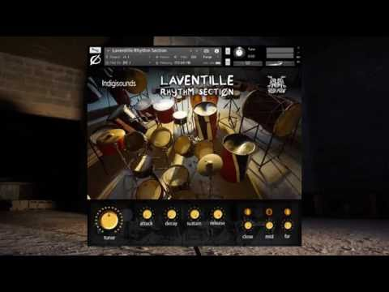
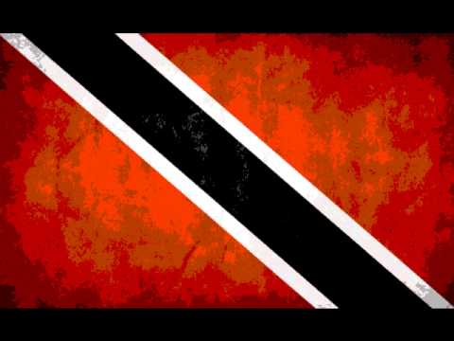
SOUND REFERENCES
https://soundcloud.com/chowmasta/lrs

Slide 5
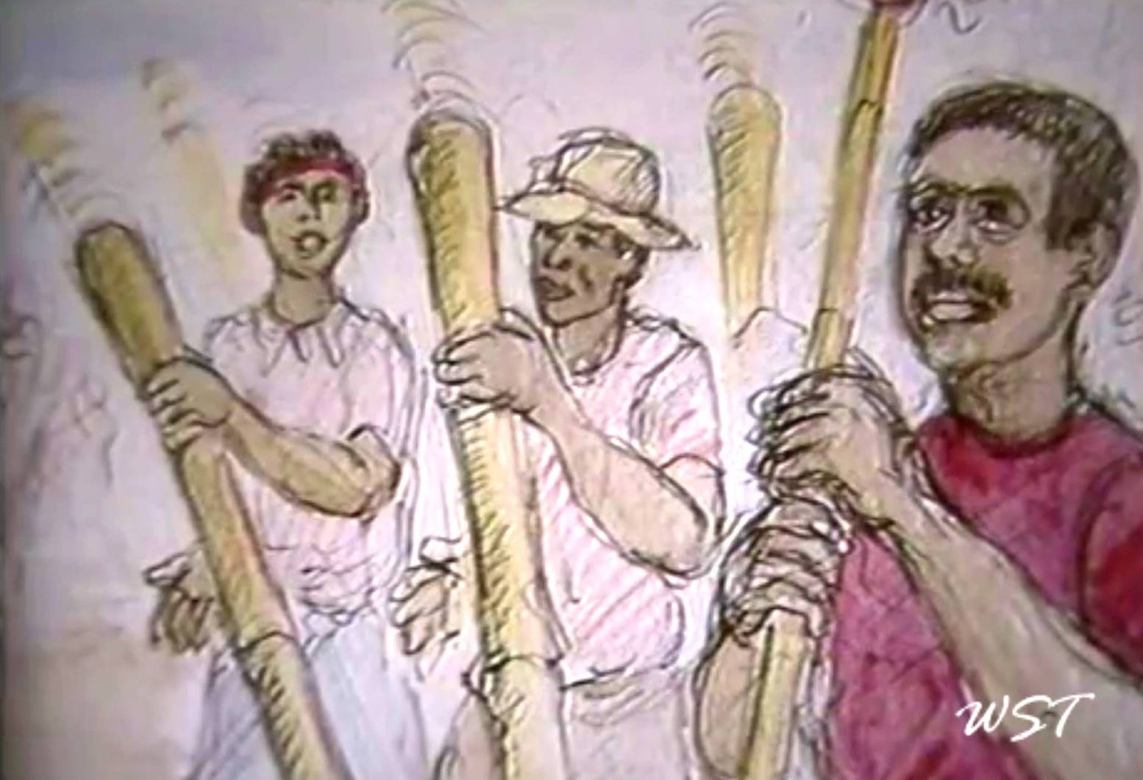
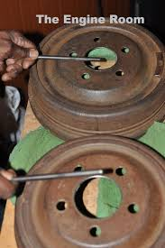
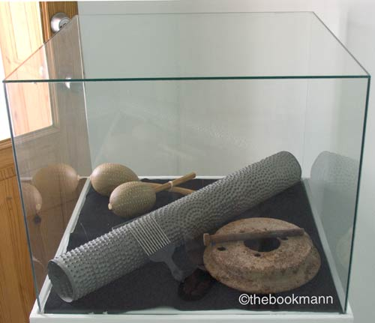
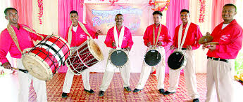
INSTRUMENT REFERENCE
Notes:
Tamboo bamboo - an instrument made from the hollowed out bamboo
Iron - pieces of iron with different tones. very heartbeat and soul of the rhythm section
Scratcher - perforated iron whose surface produces a noise when metal bristles are rubbed against it
Tassa - Different drums and cymbals
African drums

Slide 6
PERFORMANCE
Showcase the disparate instruments
Add each instrument/tempo individually
To compose a rhythm (the engine room)
Then use MAX or physical attributes to manipulate the tempo and volume
Add auxiliary sounds to create a song
Notes:
NICK YULMAN - Index Boogie at PS1
Nick Yulman performs his piece Index Boogie using mechanical percussion, books and lab glass at PS1 during the M. Wells Winter Carnival, December 2011

Slide 7
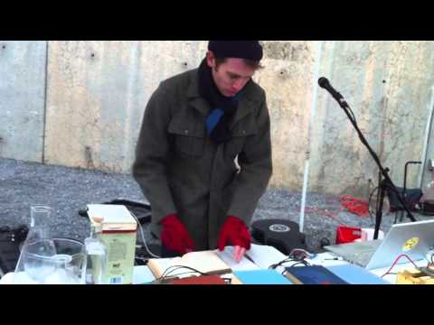
PERFORMANCE REFERENCE
Notes:
NICK YULMAN - Index Boogie at PS1
Nick Yulman performs his piece Index Boogie using mechanical percussion, books and lab glass at PS1 during the M. Wells Winter Carnival, December 2011

